Slide 2
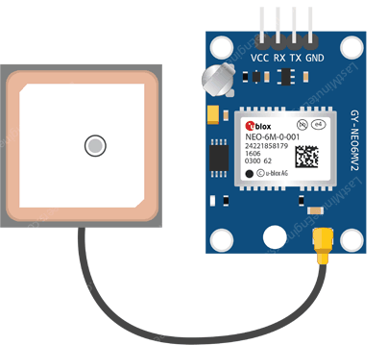
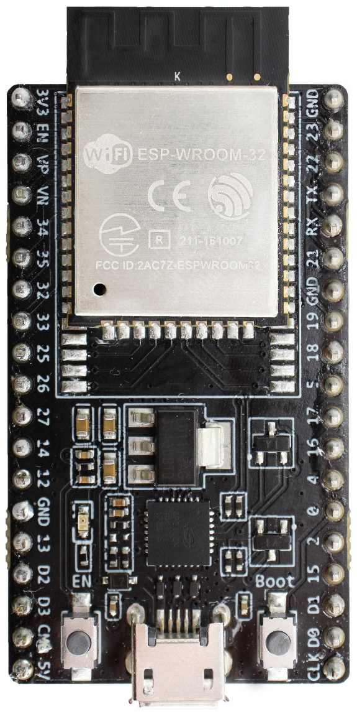
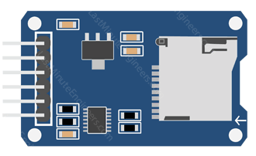

Slide 3




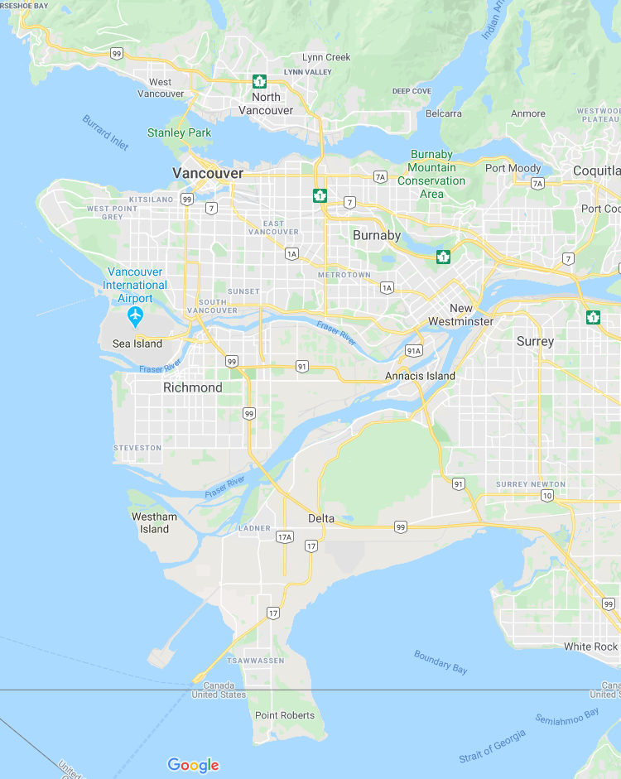
DASHBOARD :
MAP :
Device: ESP32_GPS
MAC: 00:00:00:00:00:00
Connected: YES
GPS Fix: ON
GPS: ON
Logging: OFF
Date: 20200101
Time: 00:00:00
Satellite: 8
Latitude: 000.000
Longitude: 000.000

Slide 4





DASHBOARD :

